Slide 1
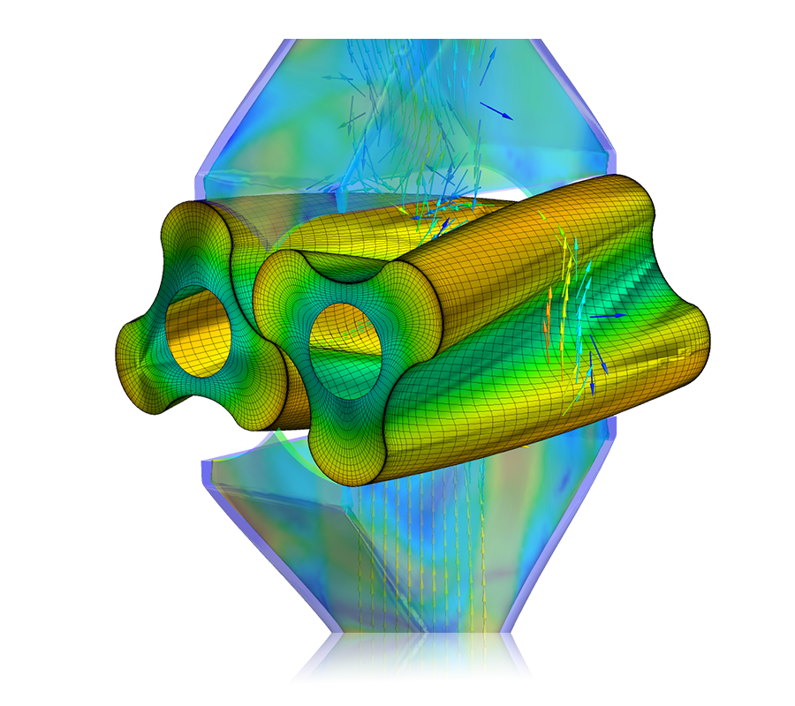
Cryogenic Integration In Modern Materials Manufacturing
Cryogenic Mechanical Systems Development For Polymer-Based Raw Materials Manufacturing
Fernando Velez (R&D Mechanical Engineer)

Slide 2
Table of Contents
  Cryogenic Ball Milling of Metallic Materials
  Cryogenic Integration In Polymer Materials
  Mechanical Engineering Methodology
  Achieving Cryogenic Temperatures
  Cryo-Burr Mill Temperature Achievements
  Polymer Particle Reduction Analysis
  Manufacturing Financial Overview
  Future Cryo-Burr Initiatives
2

Slide 3

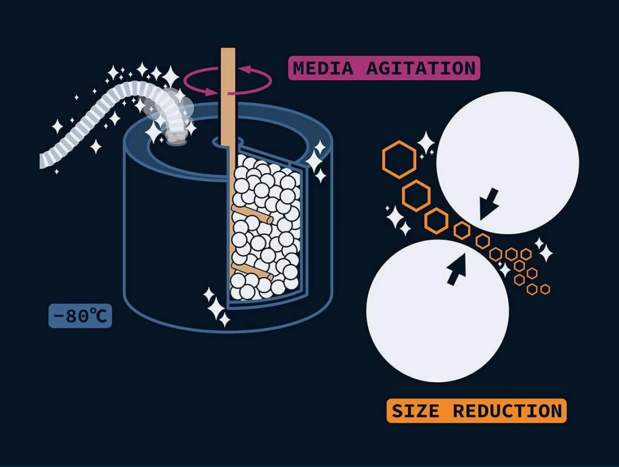
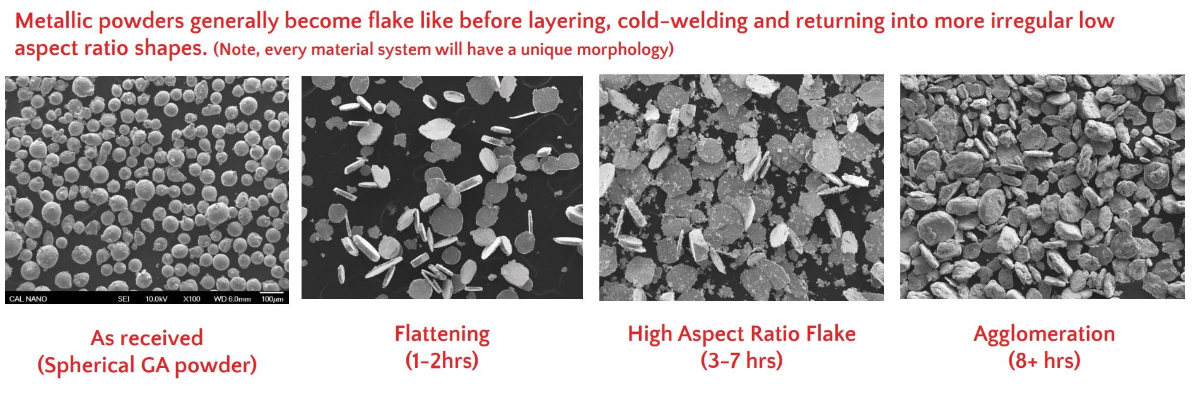
Cryogenic Ball Milling of Metallic Materials
Cryogenic Material Processing
Cal Nano advances cryogenic metal milling technologies to industrial grinding for commercial production of polymer-based materials
New R&D engineering efforts in industrial machinery, cryogenic line retrofitting, and particle size reduction methods
New customers, material processing demand, operating procedures, safety standards, and infrastructure
Metallic Powder Morphology Illustration
Cryo-milling: Material embrittlement through low temperature environments. High energy impact reduces the particle sizes of various materials into extremely finer powders
As received
(Spherical GA powder)
Flattening
High Aspect Ratio Flake
Agglomeration

Slide 4







Cryogenic Integration In Polymer Materials
Experimental Material Inflow
${\dot{m}}_{Material}$, $T_{Material}$, $P_{Atm or Forced}$
Ambient Conditions
Strategic R&D investments in polymer-based raw-materials manufacturing prototypes
Gaseous nitrogen replaces cryo-liquids for industrial grinding of polymer materials
Polymer-based materials operate at distinct glass transition temperatures
Prototype technology requires new engineering design and experimental testing
Mechanical systems offers greater control in polymer particle size reductions
$$T_{Ambient}$$
$$P_{Ambient}$$
Nitrogen Inlet
Control System
$$T_{Nitrogen}$$
$$P_{Nitrogen}$$
Heat Generation
$${\dot{Q}}_{Gen}$$
Energy System Input
Heat Transfer
$$E_{Total}$$
$${\dot{Q}}_{Total}$$
C.S.
Cryogenic Material Outflow
${\dot{m}}_{Material}$, $T_{Material}$, $P_{Atm or Forced}$
4

Slide 5
Mechanical Engineering Methodology
Step 1: Material Reactivity
Step 2: Nitrogen Retrofitting
Considerations:
Hybrid Machine Performance
Natural/Forced Flow
Maximum Feed Rates
Heat Development
Material Heat Mitigation
Considerations:
Optimal Material Temperatures/Pressures
Applicable Nitrogen Phase-States
Ideal/Non-Ideal Conditions in System
Control Volume Analysis of Combined Properties
Gaseous Nitrogen Mass Flow Rates
Computational Analysis
CAD, FEA, CFD, Etc.
Accurate?
Experimental Data Collection
Thermocouples, Pressure Sensors, Flow Meters, Etc.
Data Acquisition in Harsh Environments
Nitrogen Material Testing
Prototyping & Experimentation
Harsh Environmental Factors
Nitrogen Material Reactivity
Step 3 Cryogenic Material Processing
Iterative Optimization
Subcomponent Redesign, Nitrogen Phase-State Adjustments, Thermodynamic Calculations, Etc.
Considerations:
Analysis of Experimental Data
Particle Size Sample Testing
Cryogenic Sampling & Quality Testing
Material Glass Transition Temperatures
No
Desired Material?
Industrialize Process
Source Applicable Equipment, Develop Supply Chains, Scale Production, Standardize Procedures, Etc.
Yes

Slide 6
Cryo-Burr Mill Temperature Achievements

Slide 7
Polymer Particle Reduction Analysis

Slide 8
Manufacturing Financial Overview
Thermodynamic Diagram
Cryogenic mechanical hybrid systems resulted in large-scale production success at lower costs and personnel
Cryogenic material processing technology allowed for further particle reductions in polymer-based materials and an increase in material production
New customer orders from AbTech Industries Inc. resulted in company technology investments, rapid market entry, and greater product demand
Quarter | Particle Reduction (μm) | Production Growth (lb./day) | Customer Demand
Q1 | ~710 | ~50 | 1,000 lb. / month
Q2 | ~490 | ~410 | 4,000 lb. / bi-weekly
8

Slide 9
Future Cryo-Burr Initiatives
Increase robustness of cryogenic hybrid systems
Integrate further safety standards & operations
Identify new opportunities and industry sectors
Scale infrastructure & material quality
Expand growth trends through new materials
9

Slide 10
Fernando Velez
R&D Mechanical Engineer
Location: Los Angeles, CA 90063
Phone: +1 (323) 852-2014
Email: fernvel36@gmail.com
LinkedIn: https://www.linkedin.com/in/fernando-velez-679118192
10

Slide 11
References
California Nanotechnologies Advances Commercial Production with Two Purchase Orders and ISO 9001 Certification. (Apr 21, 2025). https://www.calnanocorp.com/california-nanotechnologies-advances-commercial-production-with-two-purchase-orders-and-iso-9001-certification
California Nanotechnologies Presentation. (2023, March). https://www.calnanocorp.com/Cal-Nano-Presentation-March-2023.pdf

